Slide 1


FED TAPERING
WHY INFLATION IS NOT ALWAYS BAD

Slide 2

Understanding why Inflation is not always bad

Slide 3
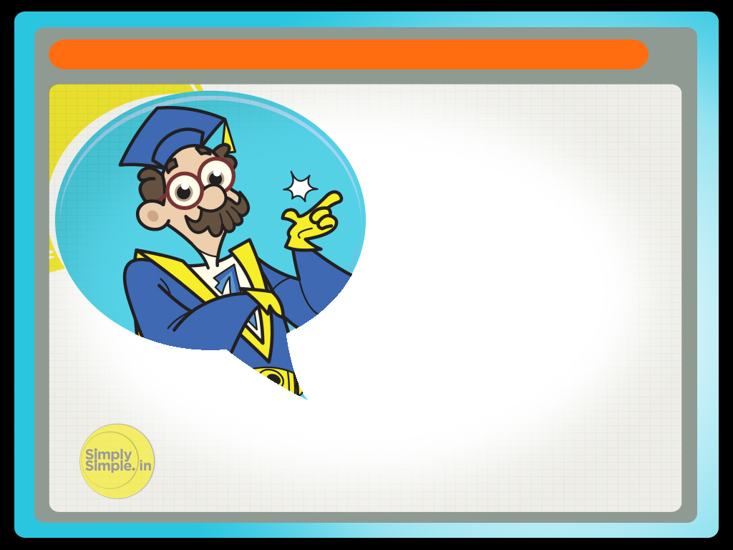
WHY INFLATION IS NOT ALWAYS BAD
Why would somebody want inflation?
Ask an Indian and he will want to stare you into ashes.
But ask a Japanese and he is all likely to smile back at you and seek suggestions.

Slide 4

WHY INFLATION IS NOT ALWAYS BAD
Thus inflation may be a bad word for us in India where everybody seems to be fighting inflation.
We call it all sorts of names like ghost or monster. But elsewhere inflation is not necessarily a bad omen.

Slide 5

WHY INFLATION IS NOT ALWAYS BAD
In fact “inflation” is the rally cry in Japan to reverse the economy from the brink of coming to a standstill and going nowhere.

Slide 6
WHY INFLATION IS NOT ALWAYS BAD
To understand this it is imperative to see “inflation” as a dividing wall between consumers on one side and manufacturer on the other side.
Consumer
Inflation
Manufacturer

Slide 7
WHY INFLATION IS NOT ALWAYS BAD
Inflation
The consumers always want the wall to be short so that they can easily climb up and enter the manufacturing side and use the goods and services without much effort.
Inflation
Consumer
Manufacturer

Slide 8
WHY INFLATION IS NOT ALWAYS BAD
For the sake of analogy consider “effort” equal to “money” & “wall” to “inflation”, let us use it interchangeably.
Therefore for consumers a shorter wall means lower prices.

Slide 9
WHY INFLATION IS NOT ALWAYS BAD
But the manufacturers on the other side think exactly the opposite. They would like the consumer to spend more money in climbing the wall before they can enter the manufacturing side and consume goods and services.
Thus a taller wall for the manufacturer means more money and profits.

Slide 10
WHY INFLATION IS NOT ALWAYS BAD
Thus high inflation or a tall wall is more acceptable to the manufacturer as compared to the consumer while low inflation or negative inflation might be acceptable to the consumer but is a worrying sign for the manufacturer.
However the story does not end there.

Slide 11
WHY INFLATION IS NOT ALWAYS BAD
One needs to also understand that every consumer is also a producer or connected with a producer somewhere or the other.
So while cheap goods makes him happy when he goes for shopping with his family, the same low cost of products that his company produces has become a pain for him at work.

Slide 12
WHY INFLATION IS NOT ALWAYS BAD
Because of less demand for the products that his company makes, the prices are low and so are the profits.

Slide 13
WHY INFLATION IS NOT ALWAYS BAD
As a result the company makes less money, gives a small salary and defers increments and bonus. In the absence of less money even low prices in the market does not entice him to spend much.
This further impact the market and prices keep falling because of weak demand.

Slide 14
WHY INFLATION IS NOT ALWAYS BAD
This is how the situation in Japan has been for some time. However, now the government wants to change the mood of the people by providing easy money in their hands.

Slide 15
WHY INFLATION IS NOT ALWAYS BAD
This is called Quantitative Easing which is similar to say printing money.

Slide 16

What is the effect of this move?

Slide 17
WHY INFLATION IS NOT ALWAYS BAD
1. It brings the value of the Yen down. This immediately makes Japanese exports more lucrative and creates demands for Japanese goods in the international market.
2. As consumers have more money and willingness to spend on goods and services, inflation rises resulting into depreciated purchasing power of money. This will also lead the consumers to prepone their purchases.

Slide 18
WHY INFLATION IS NOT ALWAYS BAD
3. More demand for the goods will mean that factories will invest more in capacity building which itself is a demand engine for raw material and labor.
4. Companies will hire more people to meet the increased demand.
5. The companies would pay higher wages to ensure that people work hard and keep pace with demand.
6. Money in the hands of the people through better increments and bonus etc means more domestic demand.

Slide 19
WHY INFLATION IS NOT ALWAYS BAD
This is what the Japanese PM Shinzo Abe would like to believe and is hence formulating policies accordingly.

Slide 20
WHY INFLATION IS NOT ALWAYS BAD
He believes that if parents were to increase the pocket money of children, then surely the children will start consuming more of all the goodies like ice cream, candies, toys, books etc.
And the manufacturers of these goods would make more of these products, buy raw material and hire more people to make them. The raw material maker too would hire more people to supply more raw material and so on and so forth.

Slide 21
WHY INFLATION IS NOT ALWAYS BAD
The increased domestic and international demand would increase the share prices of the manufacturing companies and we are seeing this play out in Japan. More international money would move into Japan to take advantage of this growth opportunity. We are seeing this as well today.

Slide 22
WHY INFLATION IS NOT ALWAYS BAD
Investors would sell out other asset classes in favor of Japanese equity. The drop in gold and commodity prices is a symptomatic of these policy changes. All this activity is expected to re-invigorate the Japanese economy and propel it to a growth trajectory.

Slide 23
WHY INFLATION IS NOT ALWAYS BAD
However the downside of this initiative is to ensure that inflation does not spiral out of control and begin the dampening the demand cycle. Shinzo Abe believes he can ensure a smooth take off for the Japanese economy through his actions and policy decisions.

Slide 24
WHY INFLATION IS NOT ALWAYS BAD
This mechanism is known as Abenomics, a term coined after the name of the Prime Minister Mr. Shinzo Abe. In economics such an activity whereby the government tries to re-energize the economy by inducing inflation is known as “Reflation”.

Slide 25
WHY INFLATION IS NOT ALWAYS BAD
Hope you have understood
why inflation is not always bad.

Slide 26
Please give us your feedback at
professor@tataamc.com
For more lessons visit
www.tatamutualfund.com

Slide 27

DISCLAIMER
The views expressed in this lesson are for information purposes only and do not construe to be any investment, legal or taxation advice. The lesson is a conceptual representation and may not include several nuances that are associated and vital. The purpose of this lesson is to clarify the basics of the concept so that readers at large can relate and thereby take more interest in the product / concept. In a nutshell, Professor Simply Simple lessons should be seen from the perspective of it being a primer on financial concepts. The contents are topical in nature and held true at the time of creation of the lesson. This is not indicative of future market trends, nor is Tata Asset Management Ltd. attempting to predict the same. Reprinting any part of this material will be at your own risk. Tata Asset Management Ltd. will not be liable for the consequences of such action.
Mutual Fund investments are subject to market risks, read all scheme related documents carefully.

